Slide 1
QUIZORA
A web quiz app

Slide 2
Table of contents
02
03
04
01
Quiz App
Contributions
A short description on our project
Attributing the creditors
Programs
Outputs
Html, CSS, JavaScript.
Each web page with it’s output

Slide 3
01
Quiz App
Menu

Slide 4
Quiz App Description
Our project, Quiz app, is a web application where two players will compete against each other by attending a quiz containing 5 questions each.

Slide 5
Rules:
The one with the most correct answers will be declared as a winner.
The player can skip the questions and review the answers on the winner page.
If both the players got the same score, then the one who took least time to complete the quiz will be declared as winner
Features: Our project contains some extra functionalities like timer, progress bar, results review, etc.,

Slide 6
02
Contributors
Menu

Slide 7
Prateek Panda
HTML
CSS
CONTRIBUTED
HOME PAGE
QUIZ BOX
WINNER PAGE
JAVASCRIPT

Slide 8
Mohammed Fouzan
HTML
CSS
CONTRIBUTED
ABOUT PAGE
CONTACT PAGE

Slide 9
Azgar
HTML
CSS
CONTRIBUTED
LOGO
OVERALL DESIGN

Slide 10
Jana Prasanna
HTML
CSS
CONTRIBUTED
PROGRESS BAR
NAVIGATION BAR
JAVASCRIPT

Slide 11
03
Programs
Menu

Slide 12
HTML

Slide 13
CSS

Slide 14
JAVASCRIPT

Slide 15
04
Outputs
Menu

Slide 16
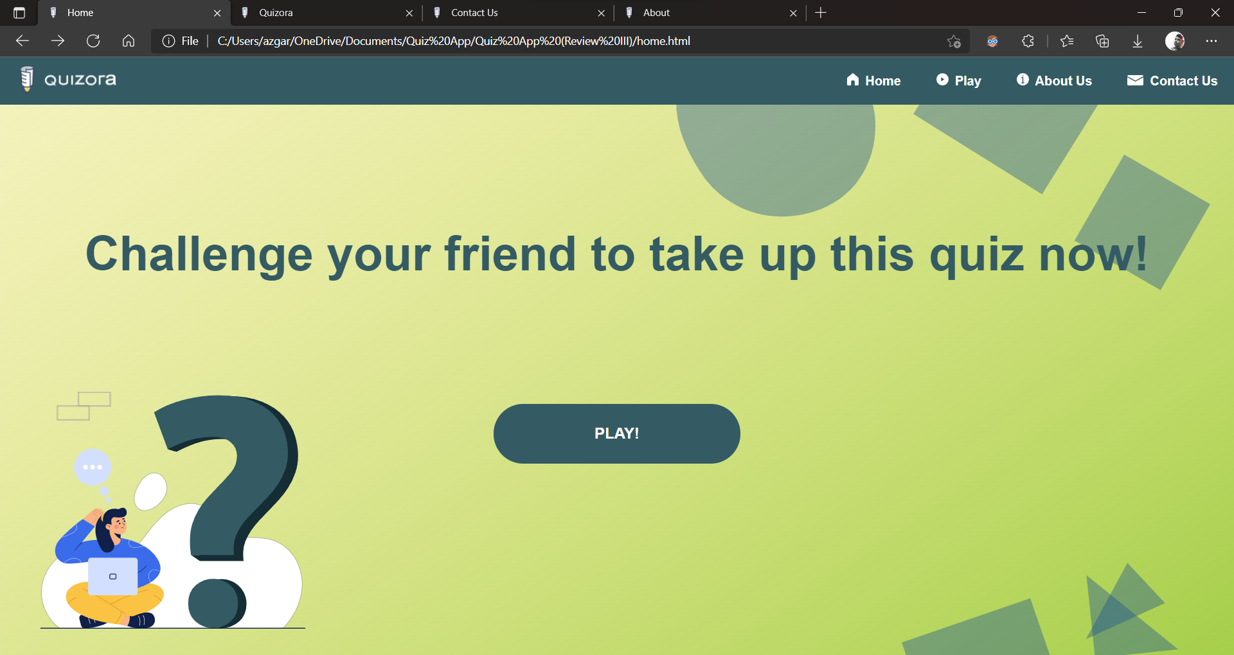
Home Page

Slide 17
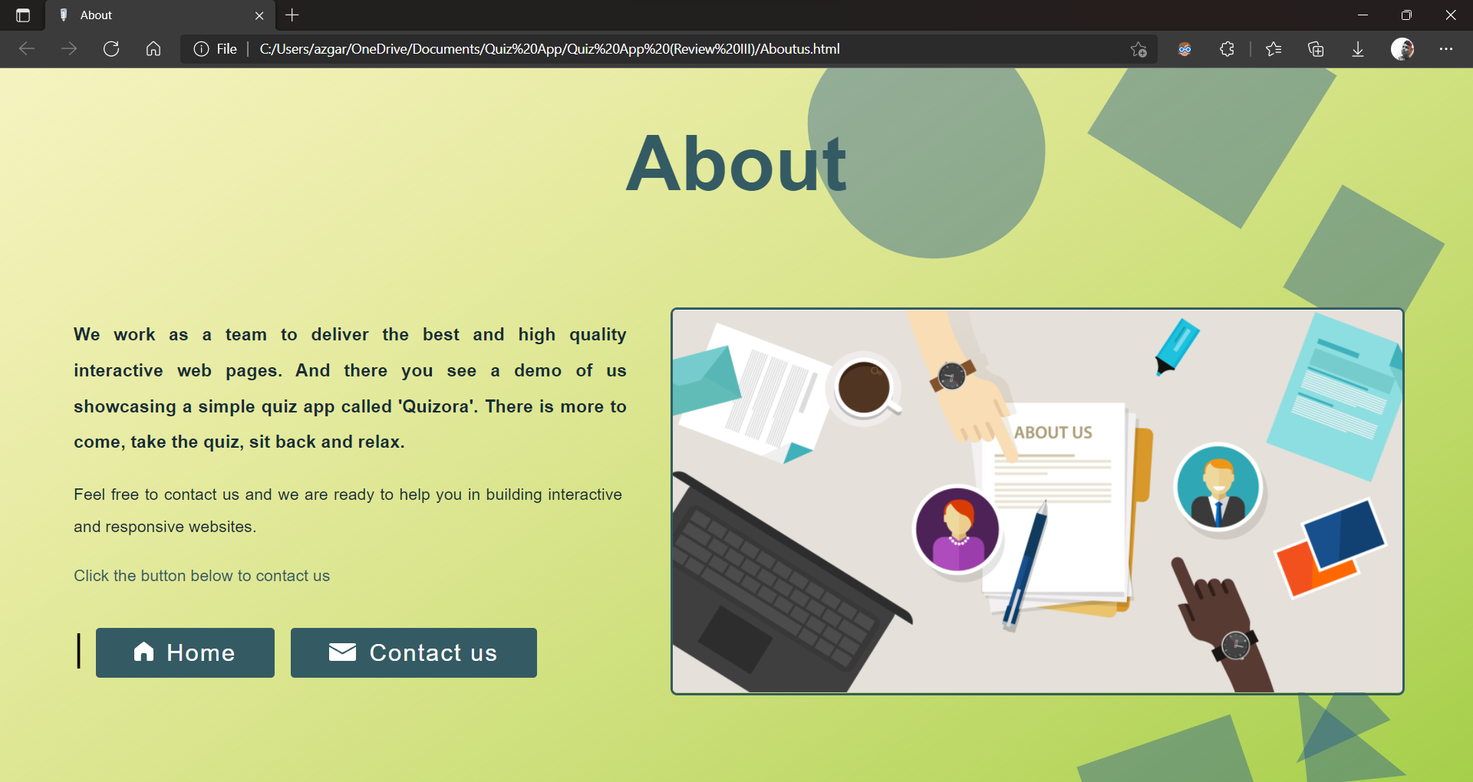
About Page

Slide 18
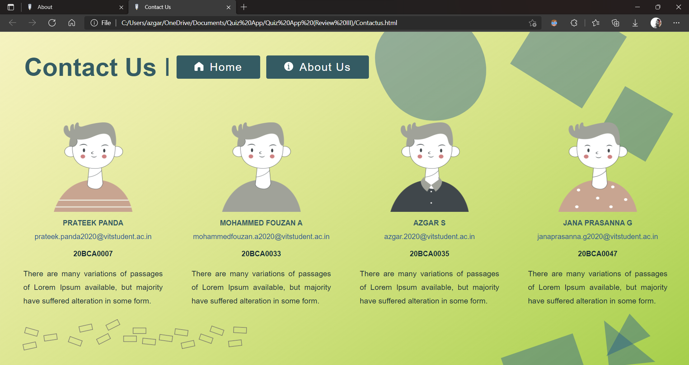
Contact Page

Slide 19
Quiz Box
The player number is displayed at the top
There is a progress bar below the name which displays the progress
Below that there is a “seconds counter” which shows the time taken by a player to complete the quiz
Below that there is a question and 4 options, out of which only one is the correct answer
The player can either choose any one option or choose not to attempt the question by simply clicking on the submit button to save time
After Player 1’s turn, player 2 can start the quiz
The winner will be displayed right after player 2 submits

Slide 20
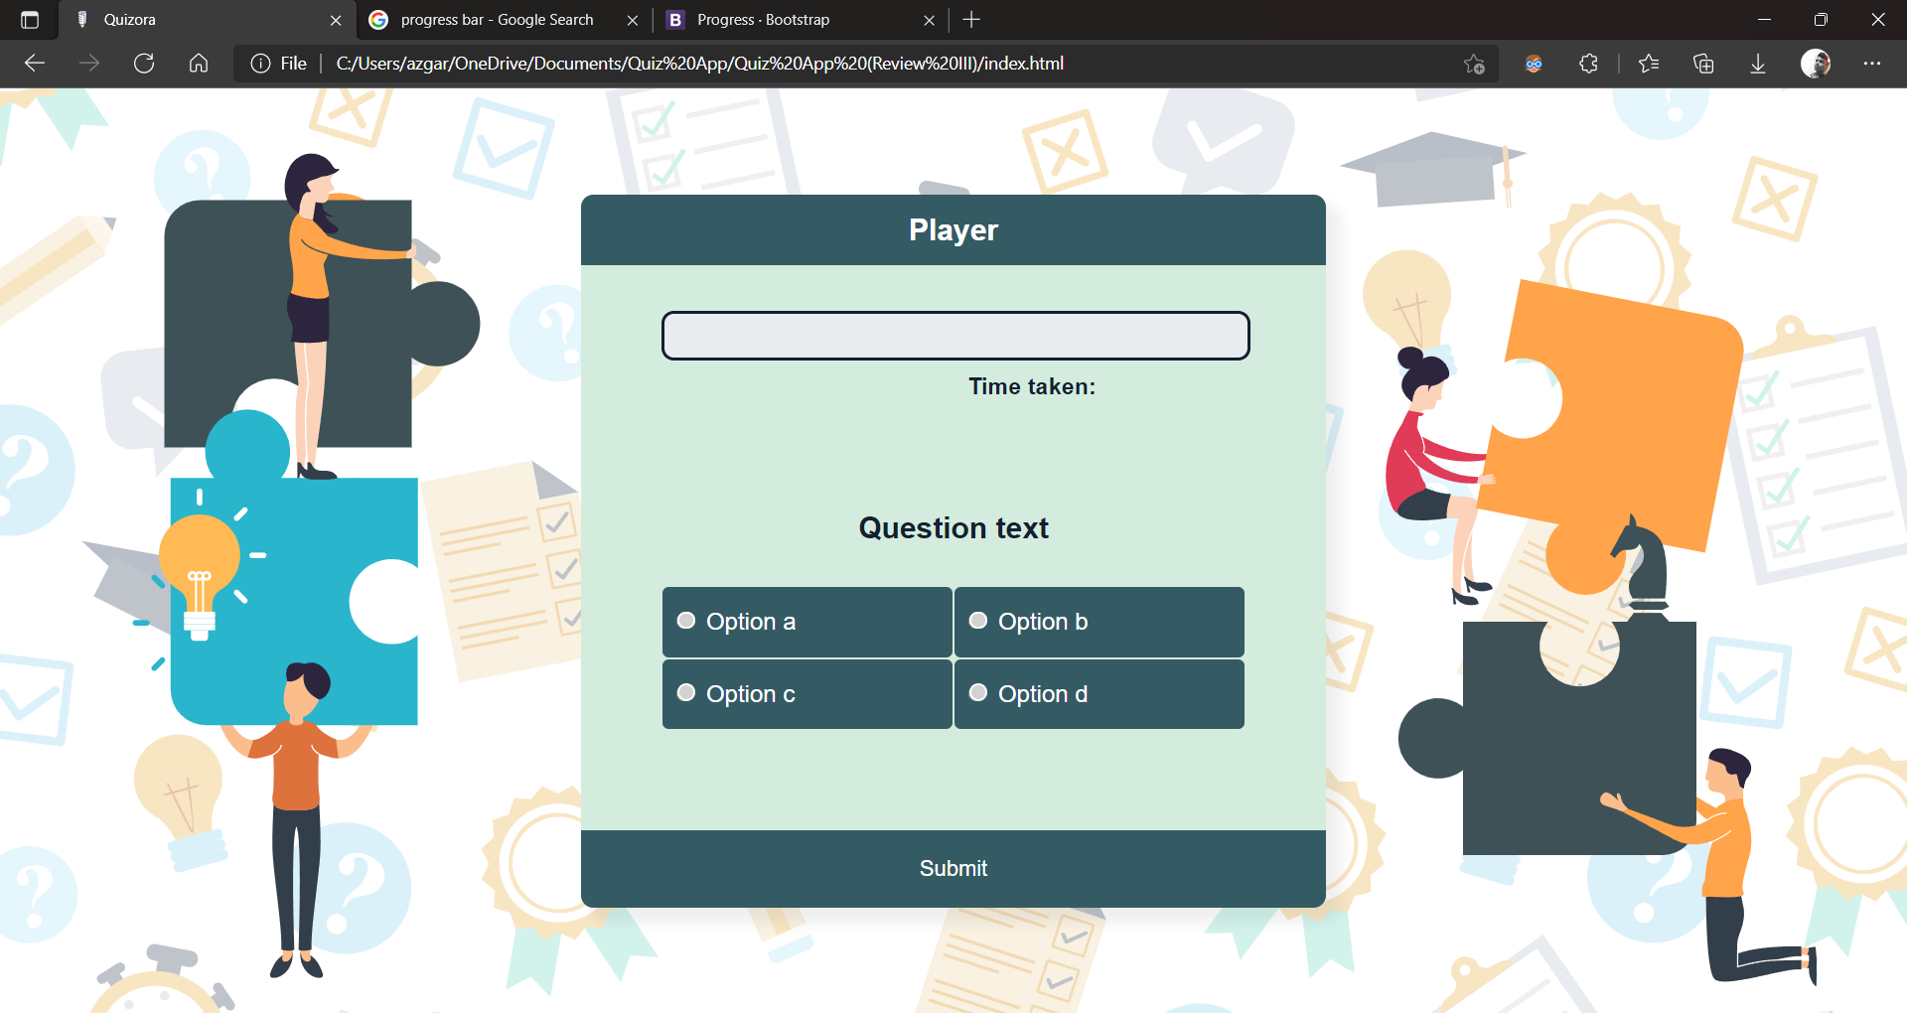
Default Player Page

Slide 21

Player Page //with JS

Slide 22

//On clicking submit

Slide 23
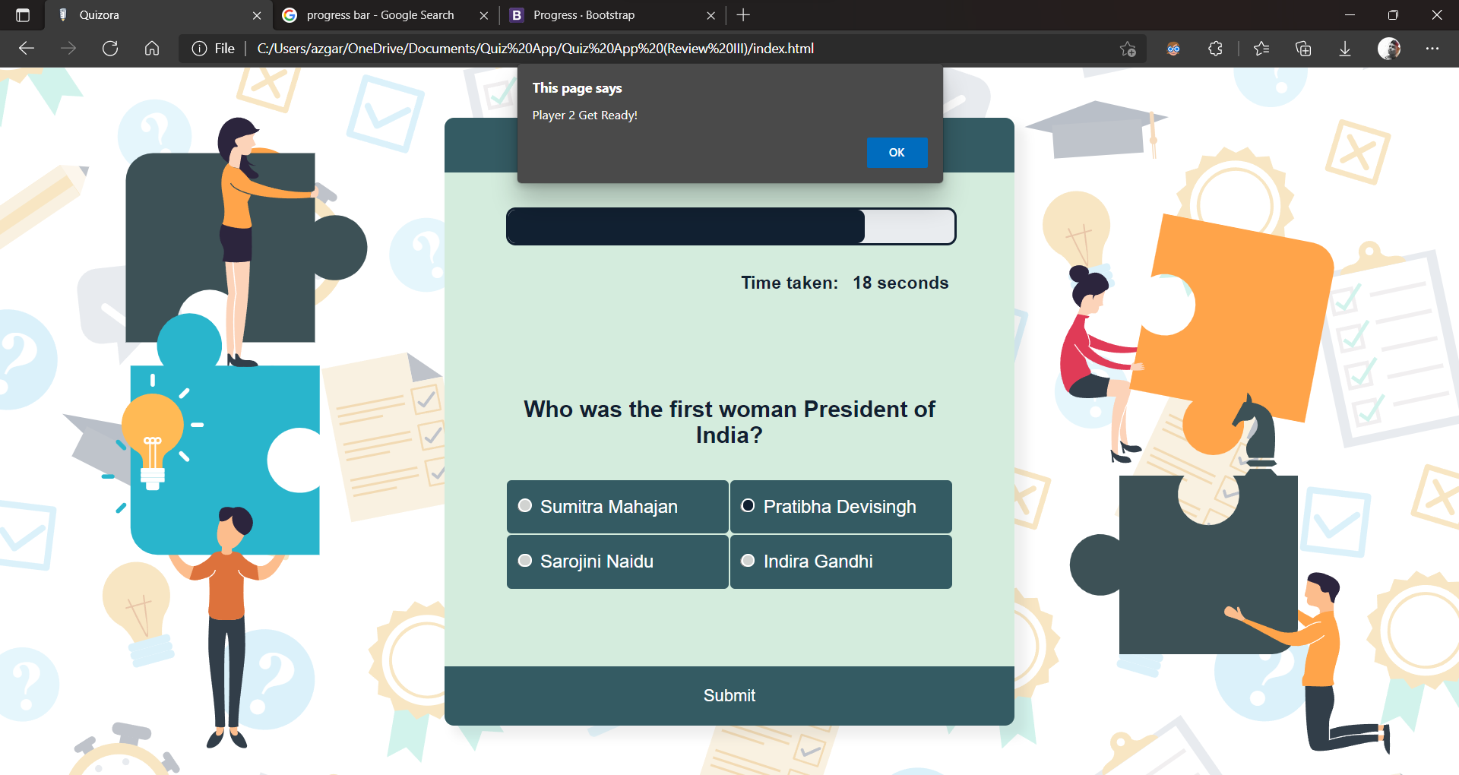
//Display alert for Player 2

Slide 24
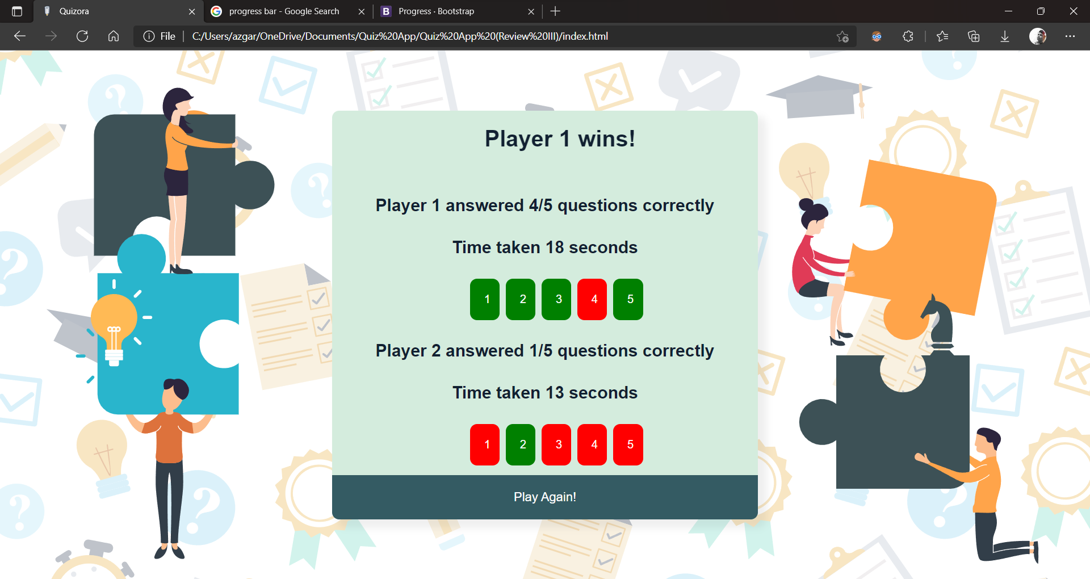
Winner Page

Slide 25
Thanks

